Slide 1
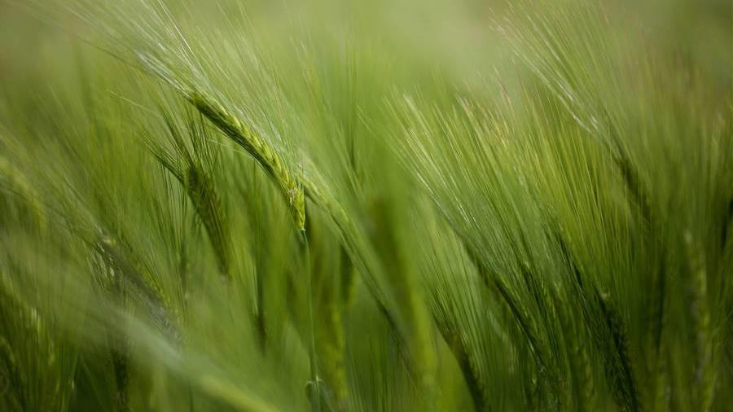
Capstone project: biodiversity in national parks
Ahmad Ammash

Slide 2
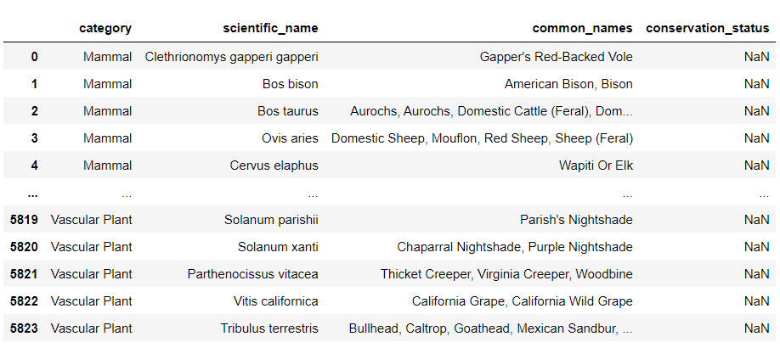
THE Dataset
The “species_info” dataset contains information on the different species present in our National Parks including their scientific names, common names and conservation status.
Observations
The dataset contains 5,824 rows and 4 columns of data on the different species present in the National Parks.
Seven unique species of animals exist in our National Parks with the vast majority of species having an unknown conservation status. The second highest proportion of species are considered as “Species of Concern” while very few of them are “In Recovery”

Slide 3
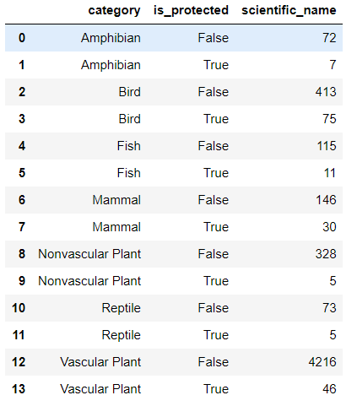
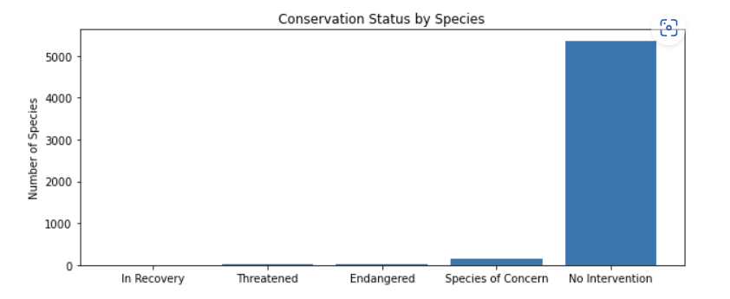
Getting ready for analysis
The data frame was grouped by the “conservation_status” column with its NaN values replaced with the string “No Intervention” (in order to make it more expressive).
The new column “is_protected” was added whose value is True or False depending on the corresponding value in the “conservation_status” column (True if Intervention is required and False otherwise).

Slide 4
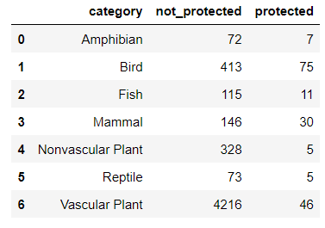
Getting ready for analysis
A pivot table was created from the existing data frame where the columns were assigned to the values of the newly added “is_protected” column corresponding to each species/category.
The “True” value column name of the “is_protected” column was replaced by “protected” while the “False” value column name was replaced by “not_protected”.

Slide 5
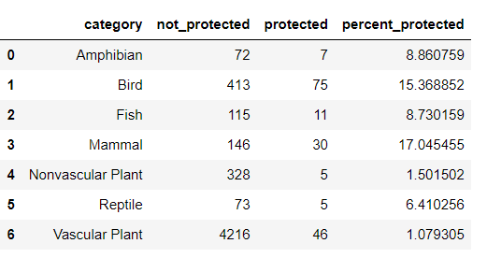
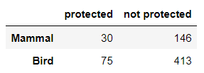
Percent endangered per species
Having grouped the dataset by the “category” column, we were able to use the newly added “not_protected” and “protected” columns in order to determine what percent of the animals that come from a specific category are protected at the National Park.
Significance testing: mammals & birds
We can hypothesize that the Mammal species is the most likely to be endangered followed by Birds and Amphibians. The species with the lowest risk of becoming endangered are Vascular and Nonvascular plants.
To test if this statement is True, we conducted a chi squared test on the Mammals and Birds species. The contingency table included the counts of protected and unprotected Mammals and Birds.
The test produced a high p-value which means the difference between Mammals and Birds is insignificant

Slide 6
Percent endangered per species
Having grouped the dataset by the “category” column, we were able to use the newly added “not_protected” and “protected” columns in order to determine what percent of the animals that come from a specific category are protected at the National Park.
Significance testing: reptiles & mammals
We conducted another chi squared test to check whether the difference in the “percent_protected” values of the Reptiles and Mammals species is significant.
We used the contingency table showing the protected/unprotected values of each species.
The chi squared test produced a p-value lower than 0.05 which meant that a significant difference exists.

Slide 7
Conclusions from significance testing
Based on the results from the two chi squared tests performed, I recommend that conservationists focus equally on protecting mammals and birds as both species are at a similar risk of being endangered (even though the percent of endangered mammals is higher).
Apart from that, other species such as reptiles are at a low risk of becoming endangered and do not need to be given a lot of attention by conservationists.

Slide 8
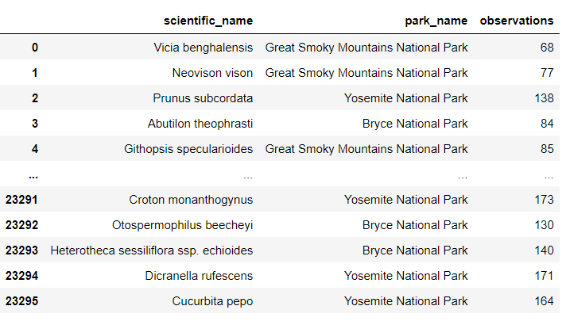
7-day species observations
The observations of species in National Parks made by conservationists were stored in the dataframe shown on the left.
The dataframe contains 23,296 rows of data and columns indicating the unique scientific name of the observed species, the park in which it was observed and the number of times it was observed.

Slide 9
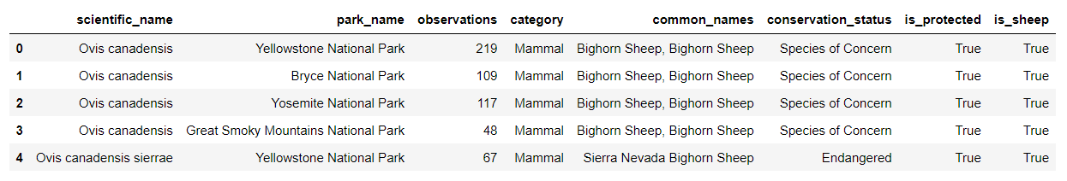
Sheep observations
The new column “is_sheep” was added to the original species dataframe. The “is_sheep” columns takes a True value when the species common name contains the string “sheep” (False otherwise).
The “species” and “observations” dataframes were merged to obtain one dataframe showing all the information related to the sheep species present in the National Parks.
We realize that all of the sheep species are protected (Intervention is required). The majority of them are considered as “Species of Concern” while one of them is “Endangered”.

Slide 10
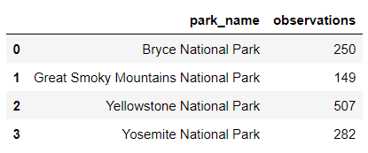
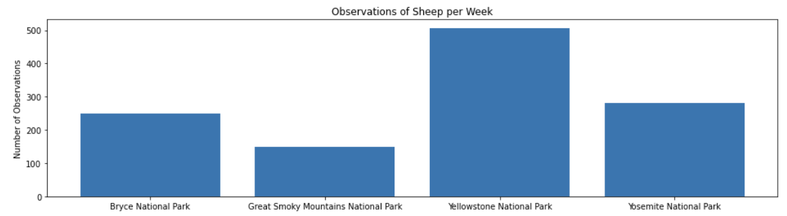
Observations by park
The sheep observations dataframe was grouped by National Park name.
We realize that “Yellowstone National Park” had the highest number of sheep observations. In contrast, conservationists observed the least number of sheep at Great Smoky Mountains National Park.

Slide 11
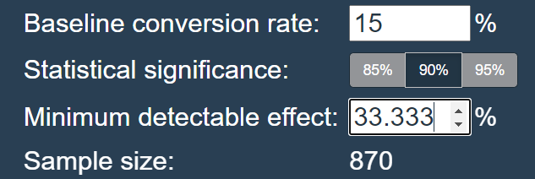
Sample size determination: sheep foot and mouth disease testing
The sample size was determined using a 15%, a 33.33% minimum detectable effect (as a percentage of the baseline conversion rate) and a statistical significance of 90%.
The calculator produced a sample size of 870.
Based on that, if we were to perform a Foot and Mouth Disease test on sheep at Bryce National Park, we would need more than 3 weeks to collect enough observations. On the other hand, we would need less than 2 weeks to gather enough observations from sheep at Yellowstone National Park.

